Slide 1

CSCI-2210-01 Java Final Project:
Warehouse Management System (WMS)
Andrew Mahr - amahr1@unh.newhaven.edu
Jake Intravaia - jintr1@unh.newhaven.edu
Andrew Manfredi - amanf1@unh.newhaven.edu
Spencer Wondolowski - swond1@unh.newhaven.edu
Antonio Lopez - alope7@unh.newhaven.edu
Dr. Reza Sadeghi

Slide 2
Project Objective
The main objective of the project is to create a Warehouse Management System (WMS) that is capable of storing the details of store products. The Warehouse Management System should allow guest users to search for different content and request to borrow/buy them.

Slide 3
Modules of Warehouse Management System
Process of our Project - Flowchart
Database Structure - Entity Relationship Diagram
Graphical User Interface Design

Slide 4
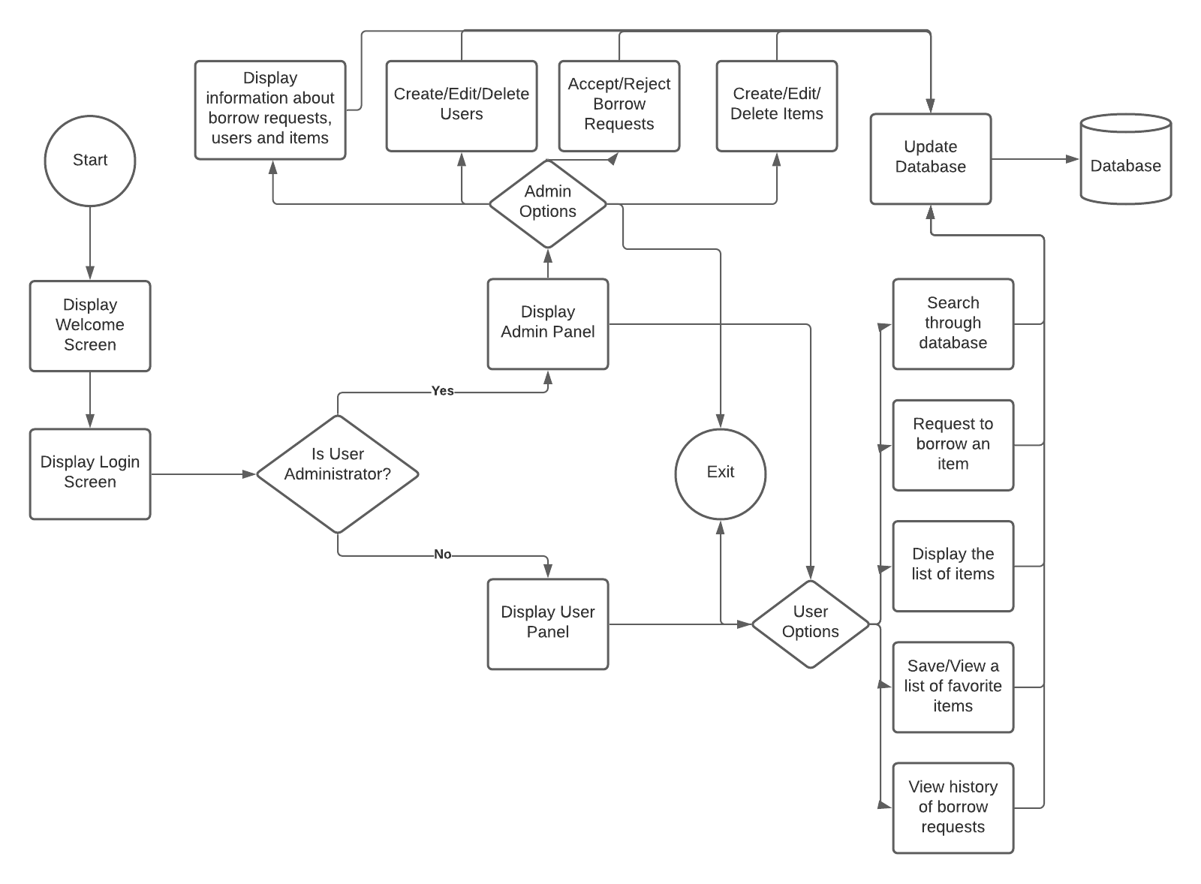
The Process of our Warehouse Management System
The flowchart for this project helped us visualize the user experience and get a firm grasp on how the program should function.

Slide 5
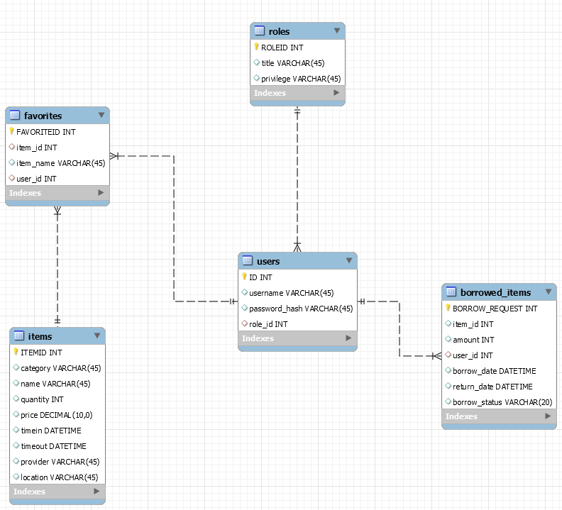
Our Database Structure
Each table has its own attributes and keys.
Key Items are designated by the Key
Green diamonds - attributes of the table
Red diamonds - Foreign Keys that reference attributes of other tables

Slide 6
Our Graphical User Interface Design
For the GUI, we decided to go with a simple but intuitive design.
The GUI of both the Login and Sign-up page is a modern design that was laid out with the intent to prevent confusing and/or overwhelming the user.
Each of the widgets displayed on the Login screen are labeled and designed for the ease of the user’s experience (UX).
The same is done for the Sign-up page, with the addition of the “confirm password” widget.
The widgets used to either login or sign-up are within a rounded box with a different color styling than the rest of the widgets, which is done to show the user that those are the main interactive widgets for the respective screen.

Slide 7
Our Graphical User Interface Design cont’d
As for the dashboard of the application, we kept the same familiar color styling to show continuity between the screens of the application.
For the dashboard, we we utilized the JavaFX frame known as a border pane, which allows us to keep our screen uniform and clean.
On the left-hand side of the screen, we have the list of functions that a typical user may utilize, such as a buttons to add and delete items from the database.
On the right-handed portion of the screen, we have a table that displays the items when queries are run.
The item display is naturally a different color than the rest of the screen to help the user easily differentiate between the menu and the important displayed information.

Slide 8
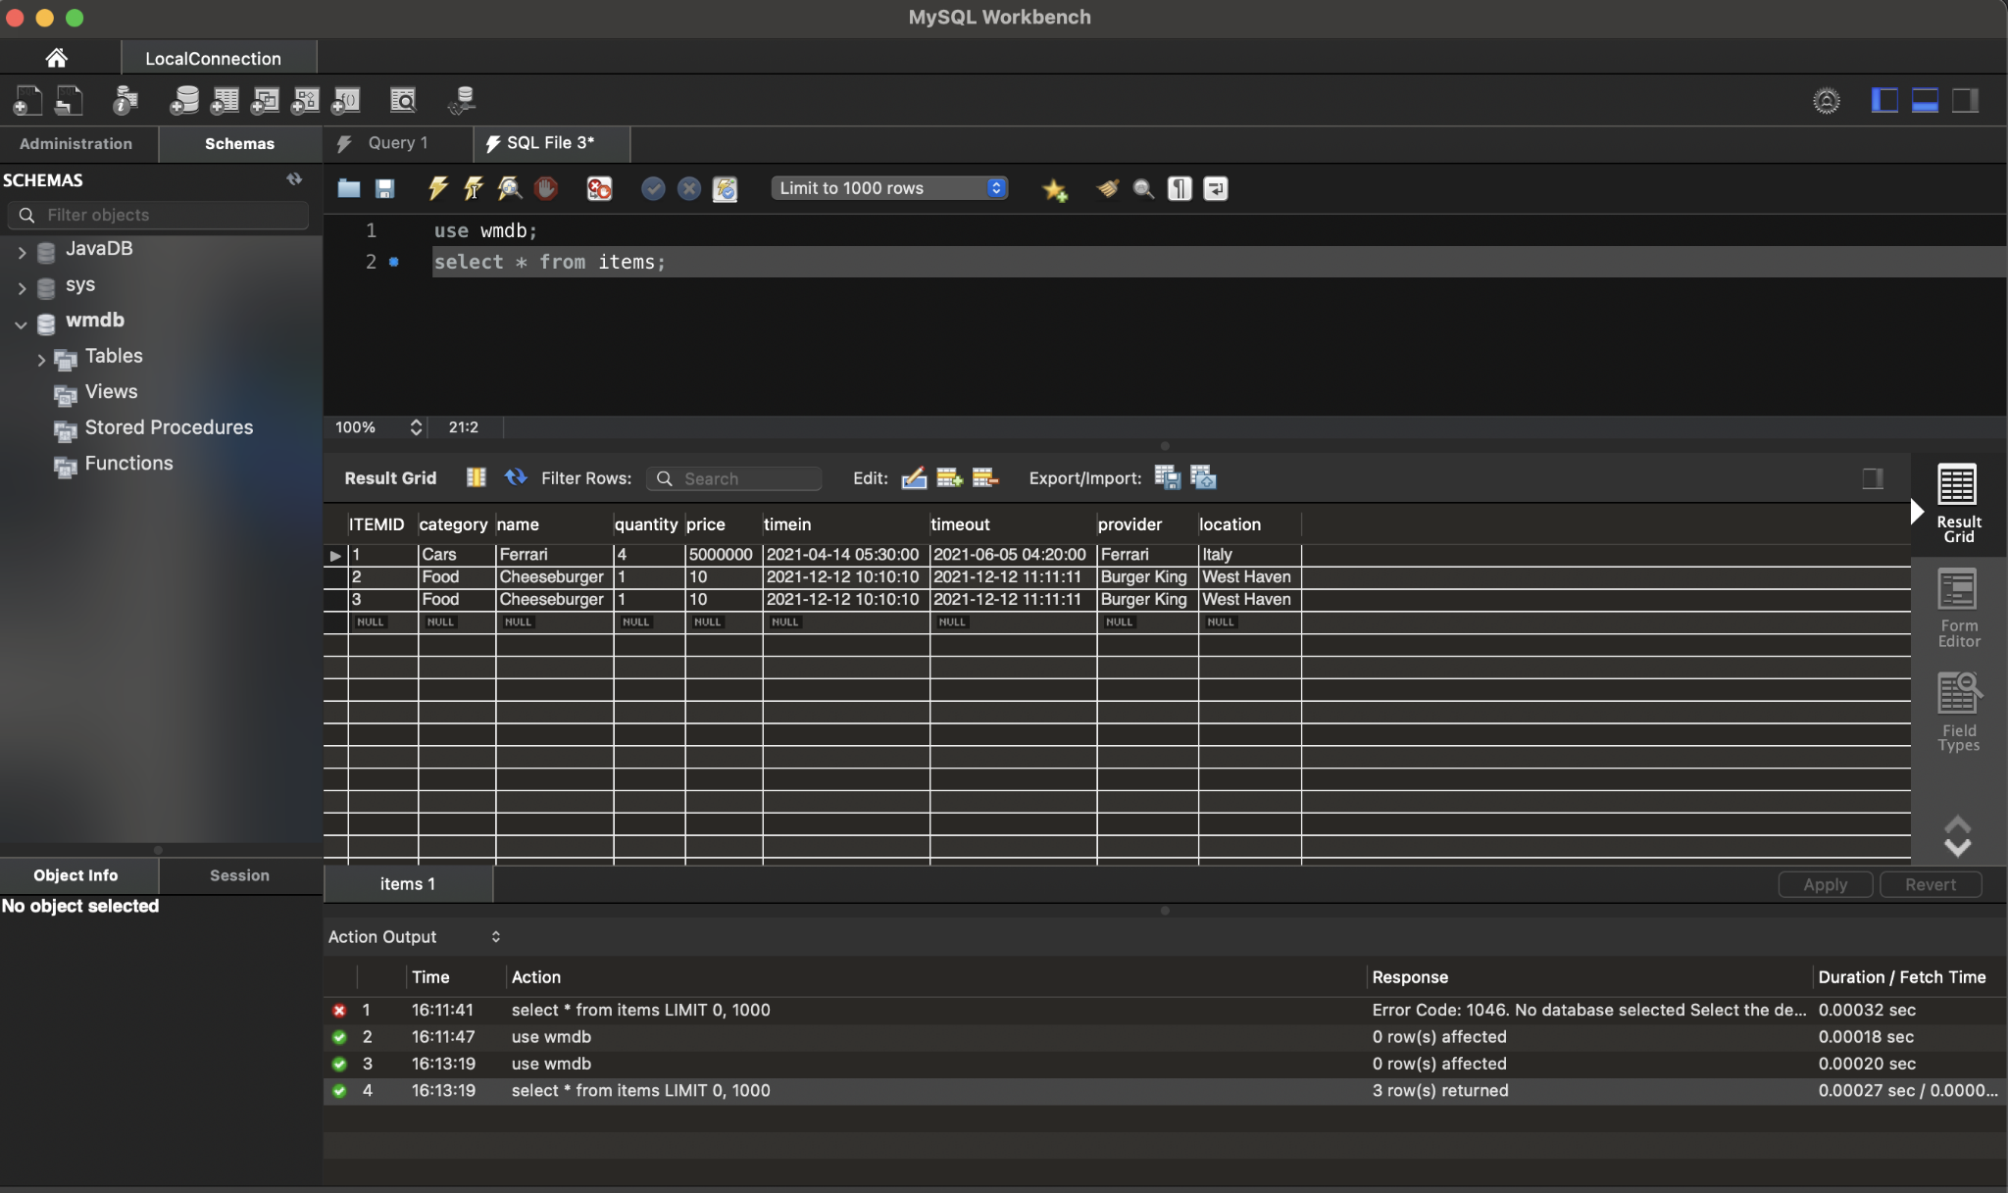
Our Database - MySQL
We used MySQL WorkBench to work with the database used to store all relevant information to our program
We also used the Java MySQL Database Driver to connect our Java Code to the database

Slide 9
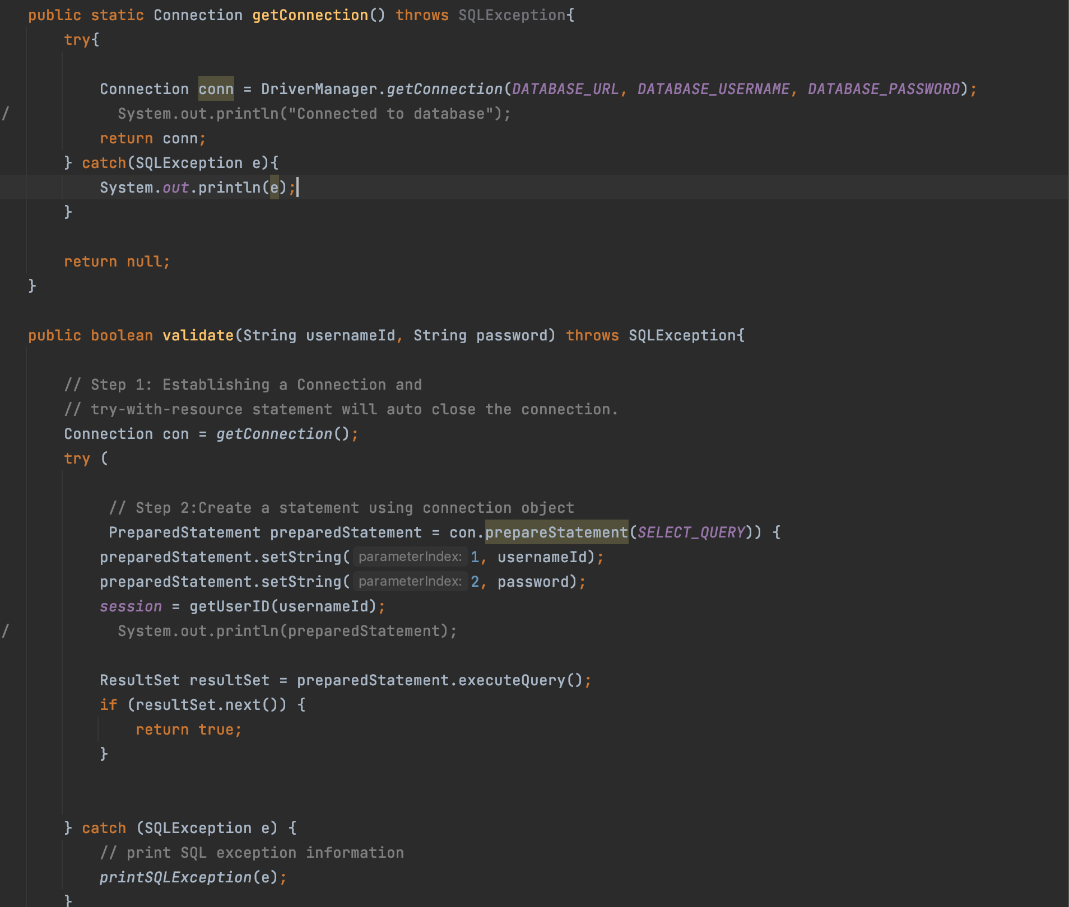
Our Database - MySQL cont’d
Connection getConnection() -
Establishes a connection to our database
validate()
Validates a user’s login information by taking in their username and password and comparing the entries to what is stored in the database (MD5 used to hash passwords)

Slide 10
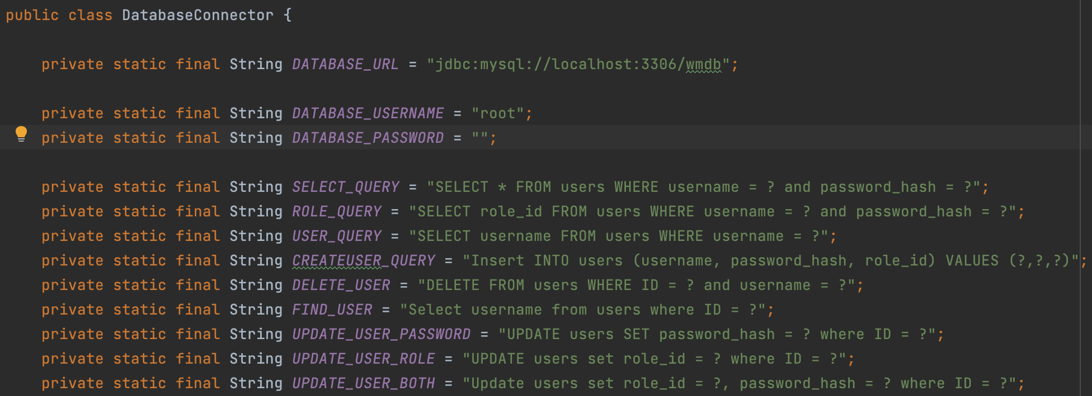
Our Database - MySQL cont’d
Our database connector houses almost all of our SQL queries, allowing us to communicate with our database and retrieve information. The class also houses multiple data verification methods - ensuring that when we ask the database for information, the information exists and doesn’t cause errors in our program.

Slide 11
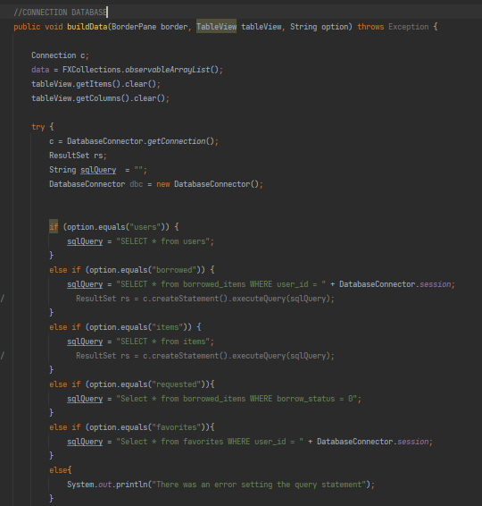
Dynamic Table View
Our DynamicTableView class was used to structure and display data to the user via the GUI. It works by first issuing a query, placing the captured data into an object array and finally placing each individual object into a row in our table. We decided to separate table building into its own class for ease of access, organization and functionality.

Slide 12
Our System outline
The Warehouse Management System is composed of several different parts listed below.
Logo Design / Loading Assets
Login Page
Loading Page
Sign-up Page
Admin Dashboard
User Dashboard

Slide 13
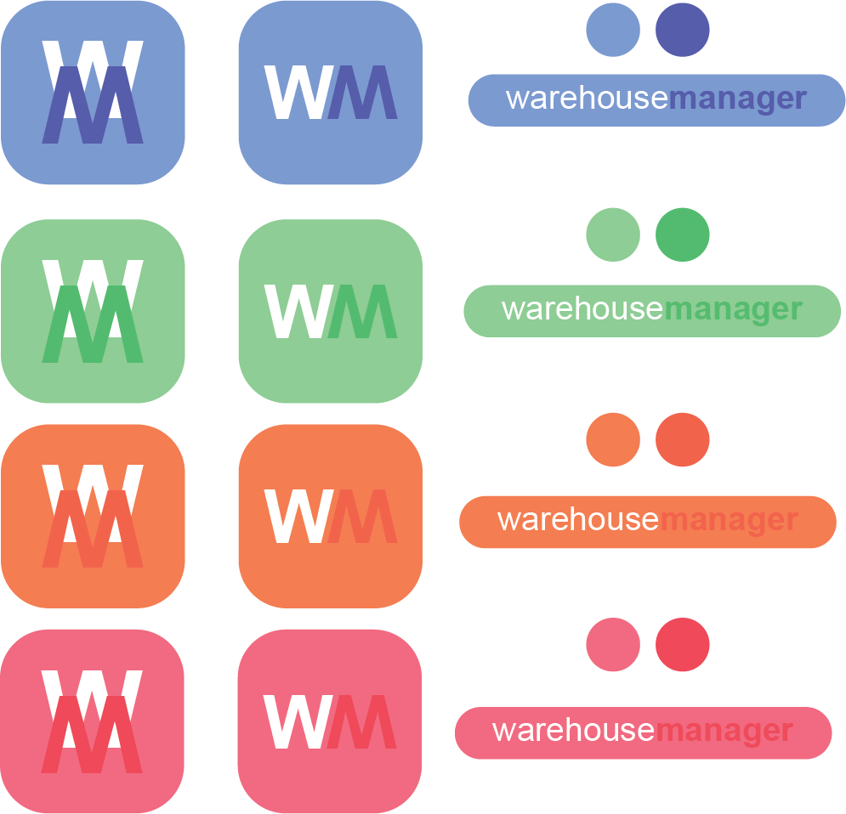

Logo Design
These logo concepts were designed in Adobe Illustrator 2021, we wanted to experiment with different colors and ended up settling on the royal blue/navy blue combination.

Slide 14
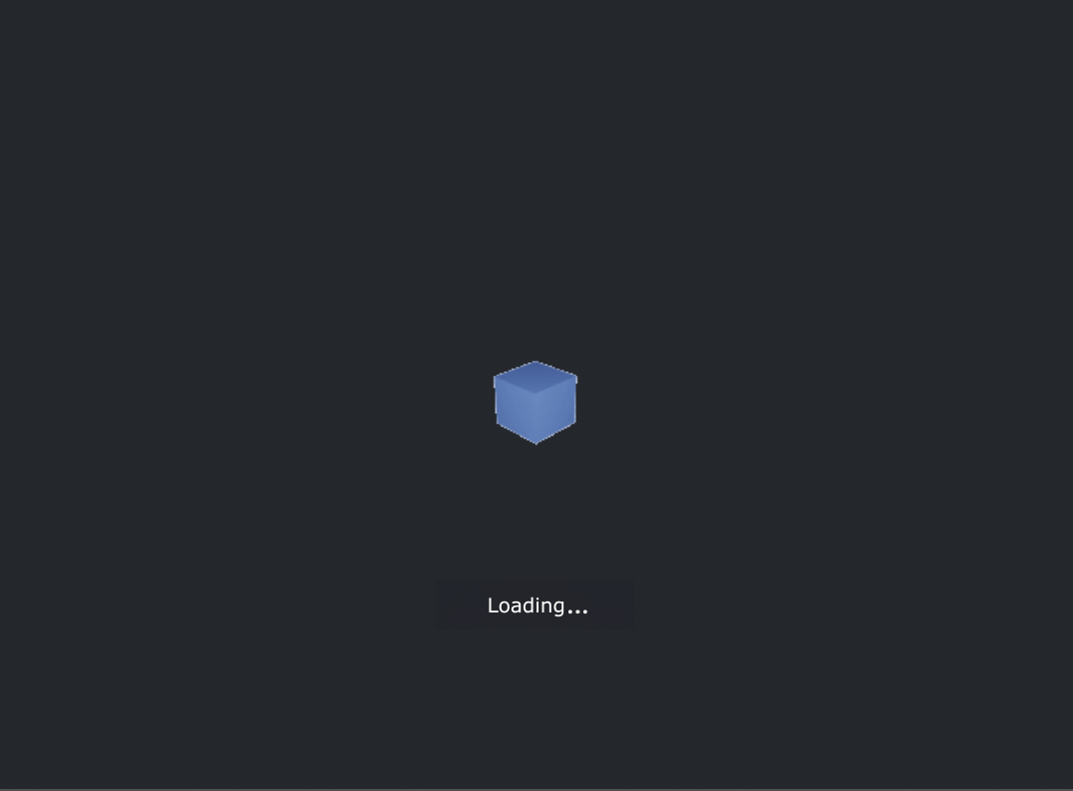


Loading Assets
The loading page for the WMS was again designed in scene builder, both GIFs used were designed and animated by our team. The box was animated and rendered in Blender, an open source 3d modeling software. The loading text was animated and rendered in Adobe After Effects 2021.

Slide 15
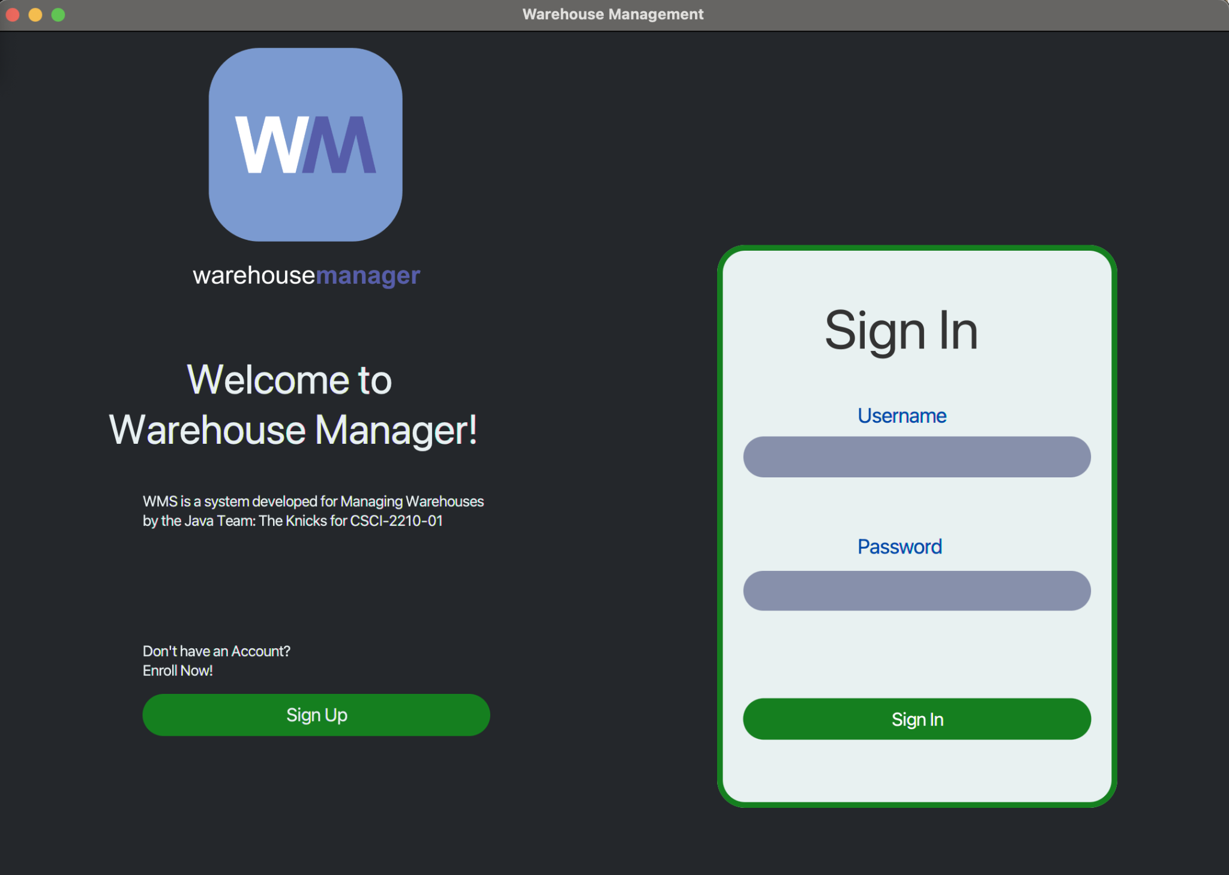
Login page
The login page was designed in SceneBuilder - a program designed to enhance the workflow of creating JavaFX based applications. The page was designed via drag and drop functionality.

Slide 16
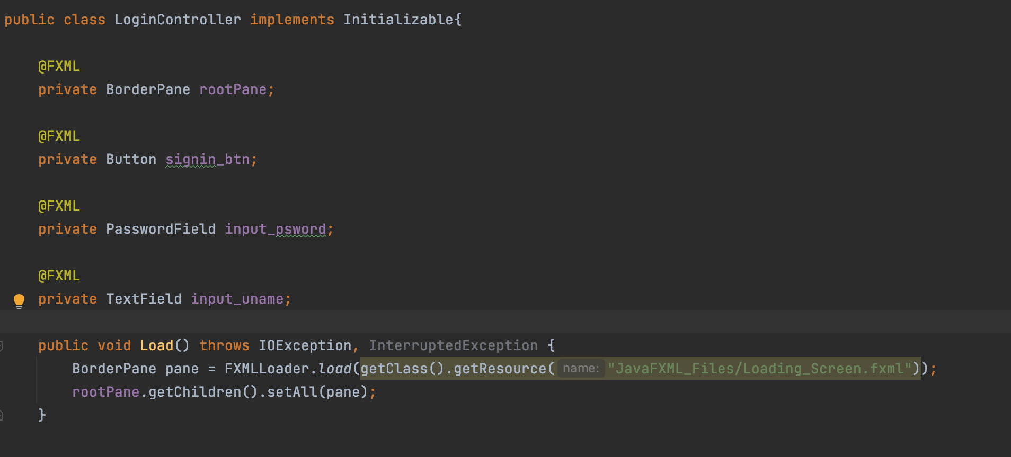
Login Page Controller

Slide 17
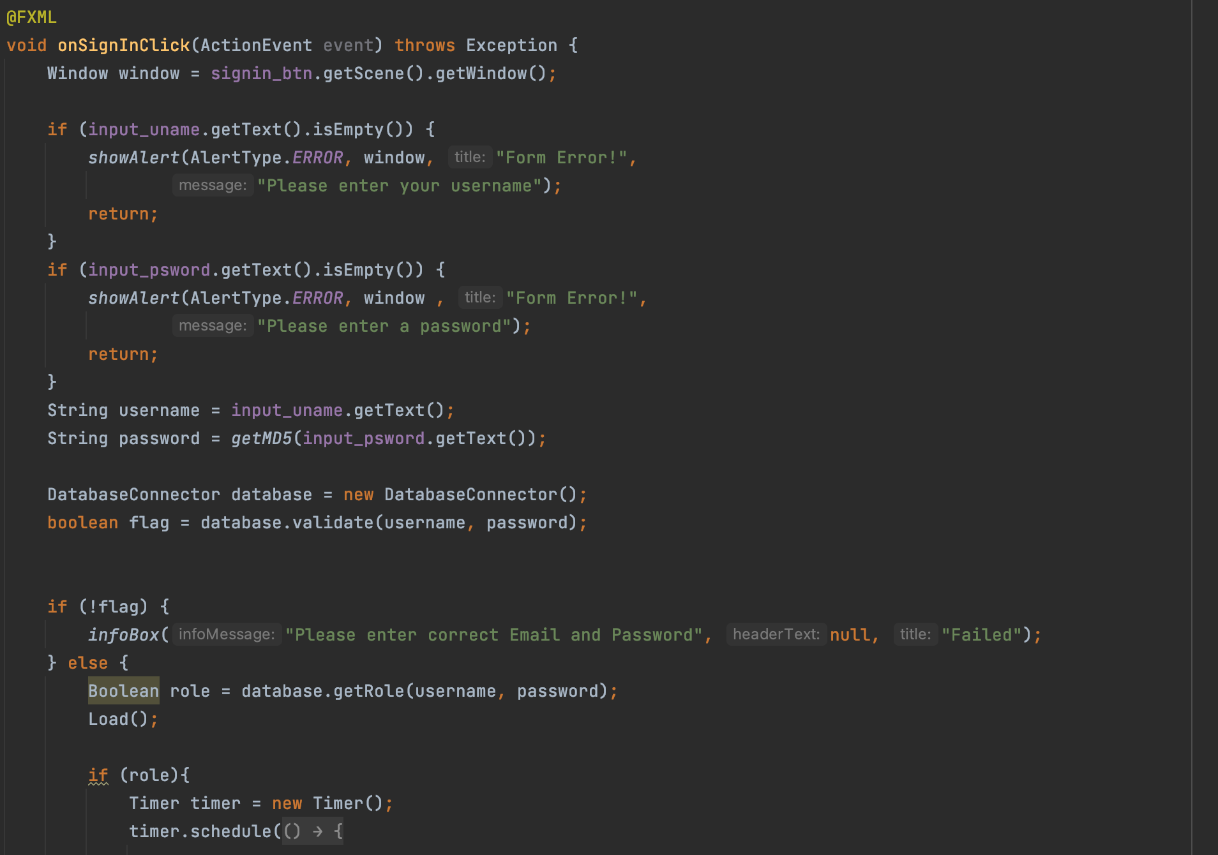
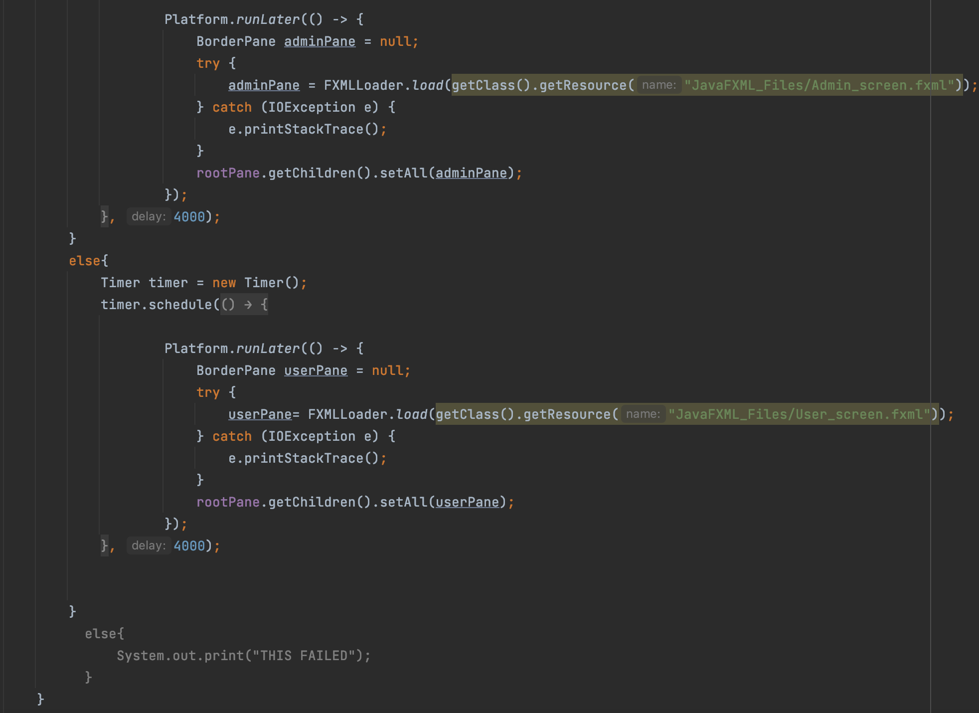
Login Page cont’d

Slide 18
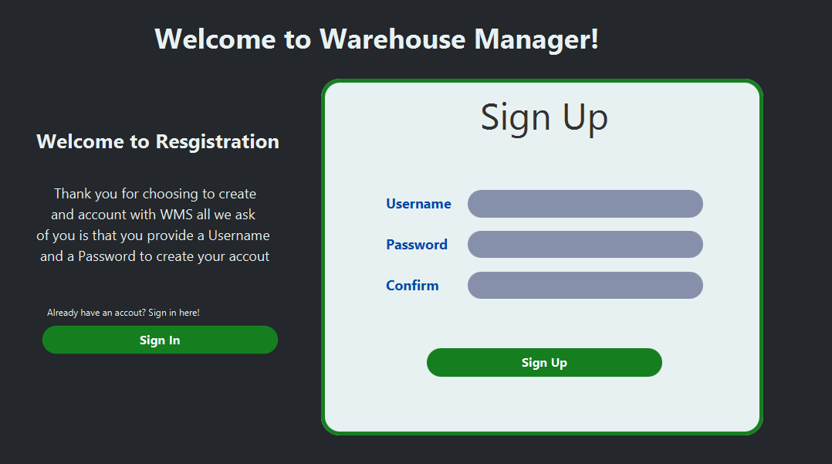
Sign-up Page

Slide 19
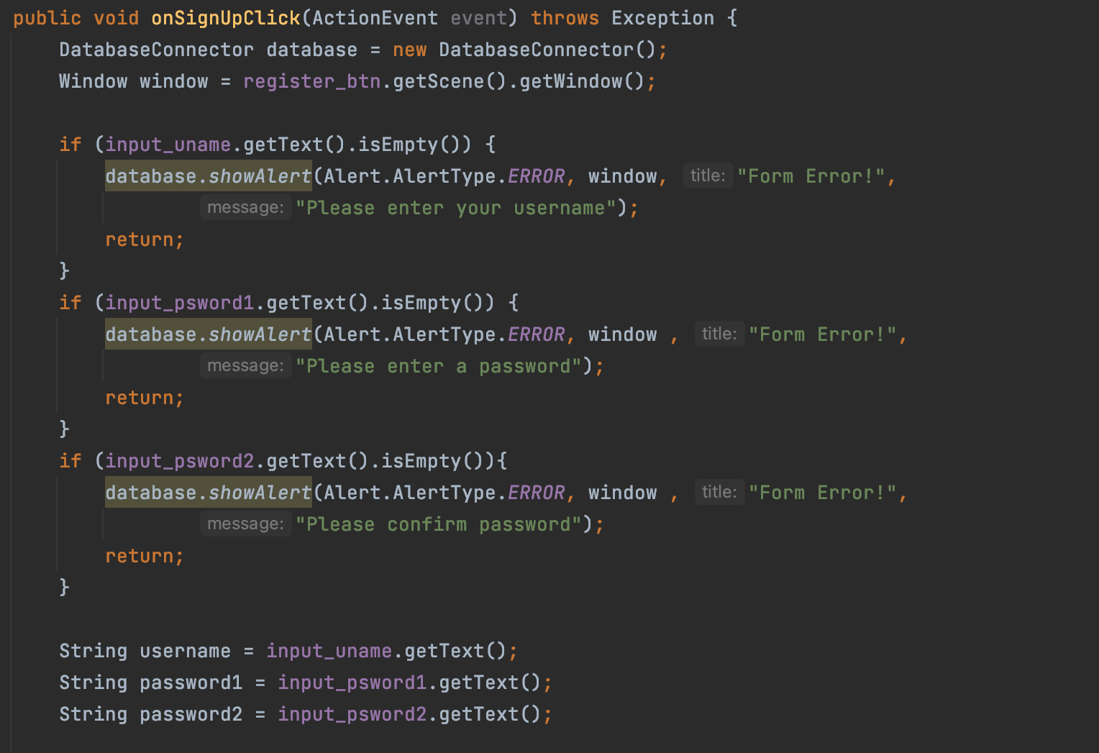
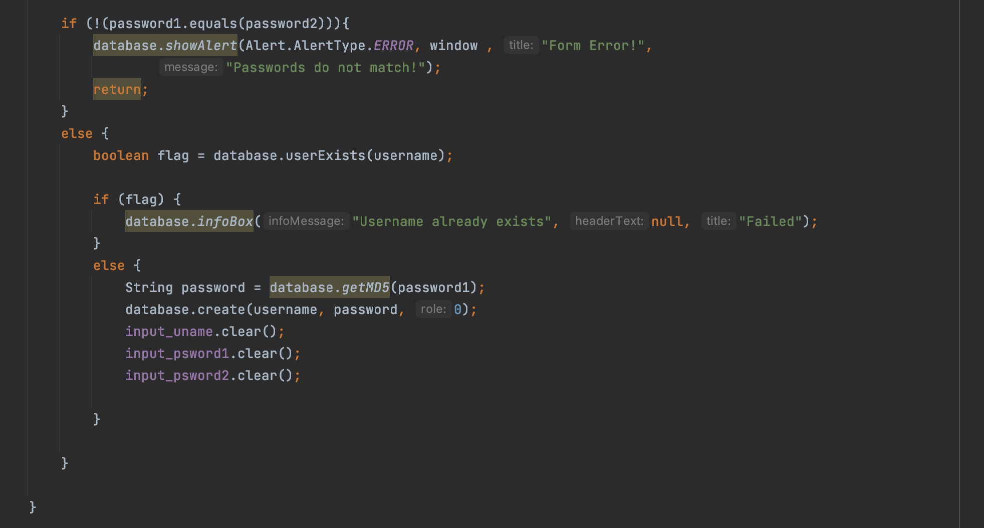
Sign-up Page cont’d
onSignUpClick(): This function handles the signup actions.

Slide 20
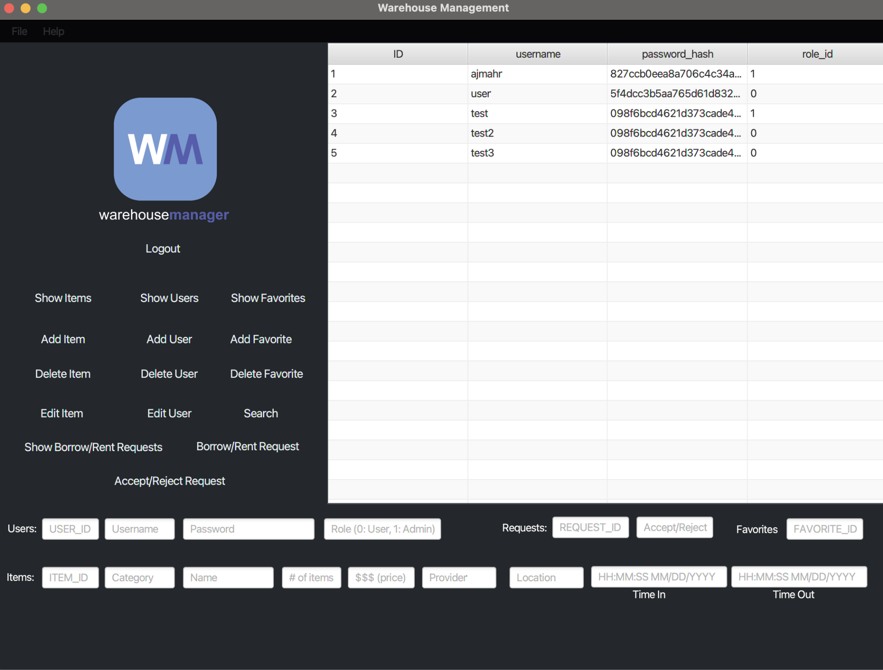
Admin Dashboard
The Admin Dashboard encompasses all of the actions that can be performed by a user, in addition to having the ability to edit items, users, and accept/reject requests.

Slide 21
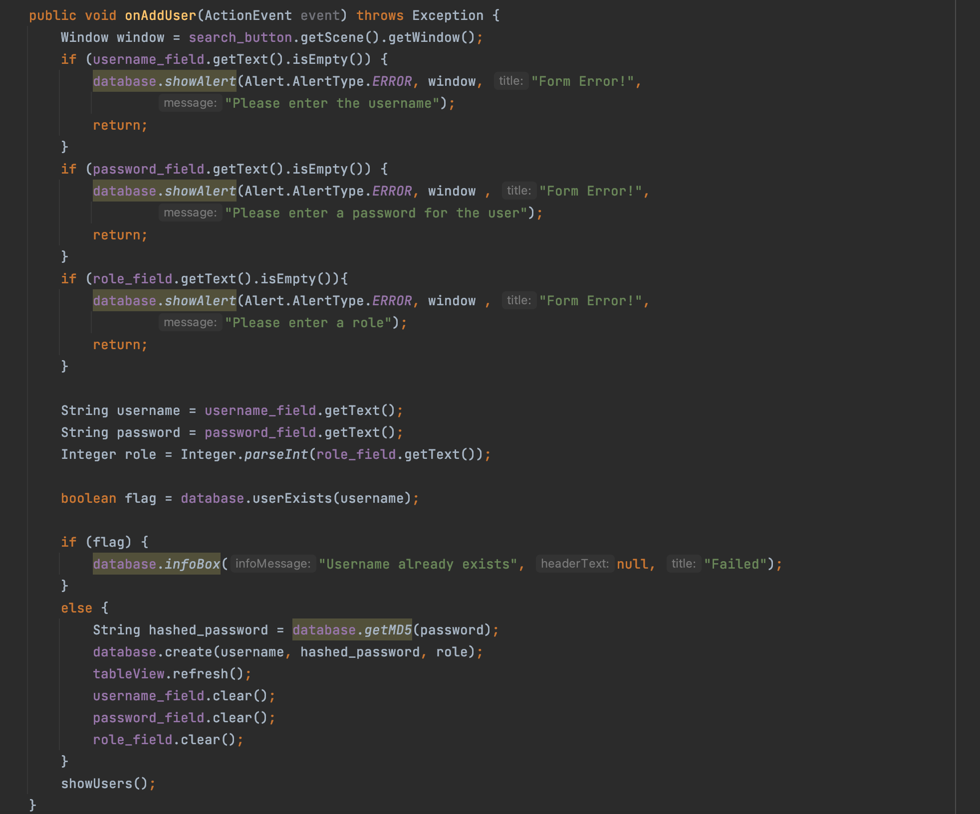
Admin Dashboard cont’d
onAddUser(): This function handles adding users when the Add User Button is pressed

Slide 22
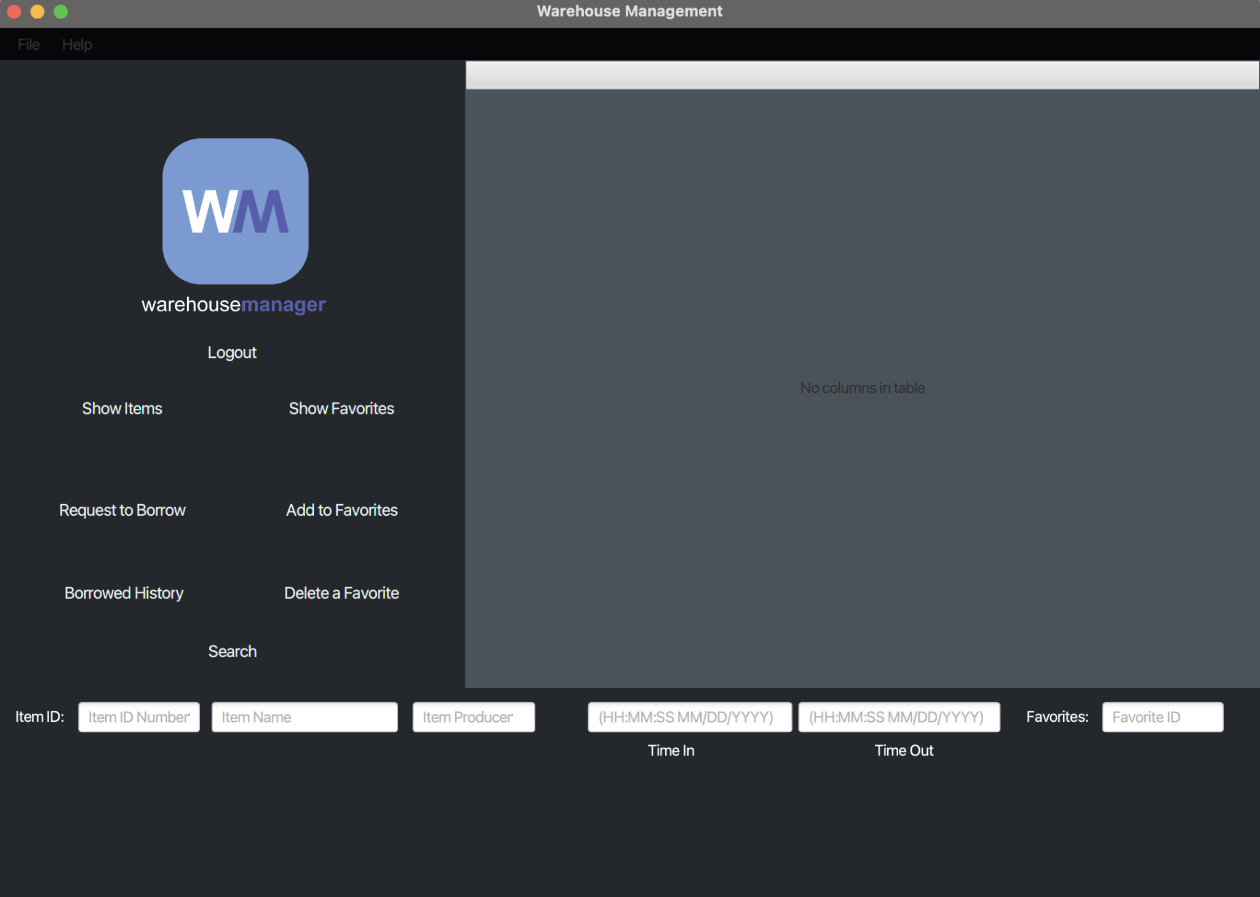
User Dashboard
The User Dashboard class encompasses all user functionality. Things like requesting/borrowing items, adding personalized favorite items, displaying different table information and more.

Slide 23
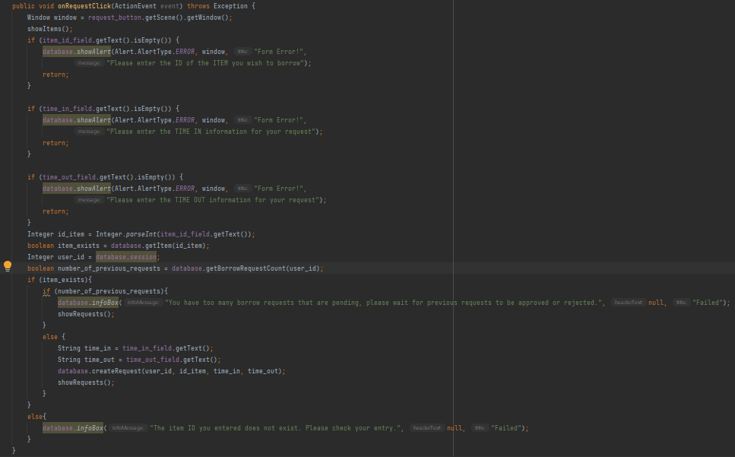
User Dashboard cont’d
This function handled the request functionality - in which each user can select an item from the database and request to borrow for an allotted time.

Slide 24
New Features
Throughout the course of our project, we implemented a few additional features to add to the enjoyment and security of the User Experience:
The Sign up and Sign in Option
MD5 Hashing of User Passwords
Loading/Exit GIF for starting and closing the application

Slide 25
MD5 Hashing of User Passwords
To enhance user security, the team decided to hash user passwords using MD5 and stored these values in the database instead of plain-text passwords.
The process to verify that passwords match:
Take user input
Hashes it
Compares it to the stored data to make sure it matches

Slide 26
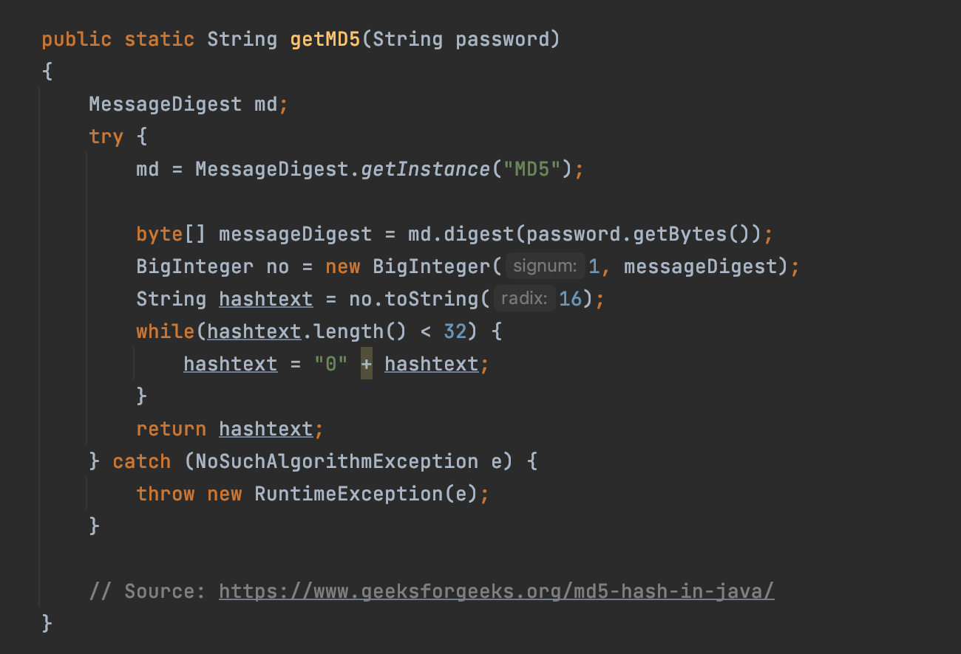
MD5 Hashing cont’d

Slide 27
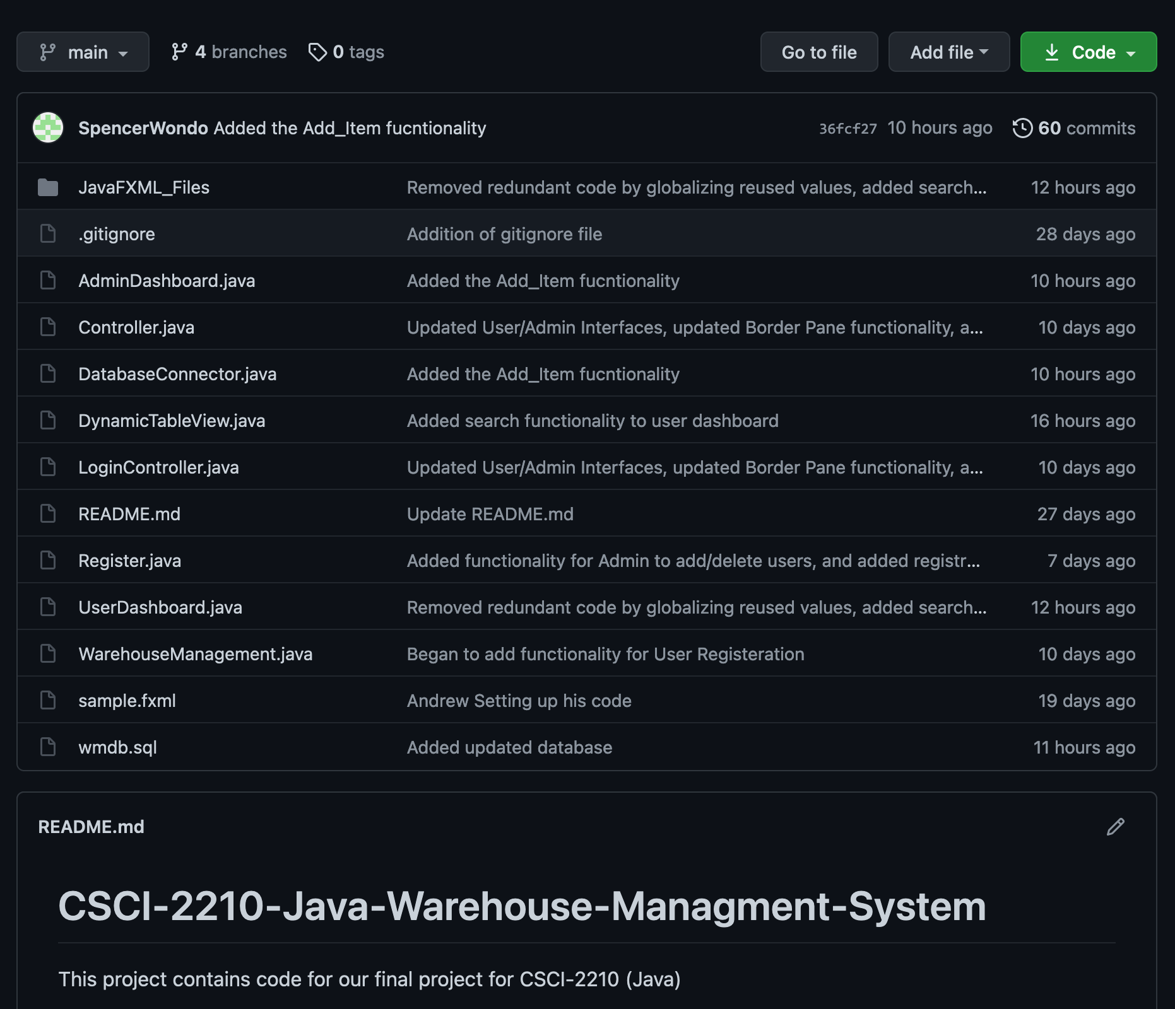
Pushing to GitHub
During the course of our project, we used GitHub to collaborate on the code and divide the work.

Slide 28

Demo

Slide 29
Questions?

Slide 30
References
https://www.geeksforgeeks.org/md5-hash-in-java/
https://stackoverflow.com/questions/26916640/javafx-not-on-fx-application-thread-when-using-timer
https://www.blender.org/
https://www.adobe.com/
https://help.umbler.com/hc/en-us/articles/202385865-MySQL-Importing-Exporting-a-database#:~:text=Importing%20a%20database%20from%20a,File%20and%20select%20the%20file
https://www.mysql.com/products/workbench/

